Slide 1
WHO AM I

Slide 2
WHO AM I
The gale of my unite:
1_the child able to know each part of the body.
2_the child able to understand some parts of the body can move.
3_the child able to recognize they have 5 senses.
4_the child must know the way for clean.
WAFA HUSAIN
200816212

Slide 3
I have body
The part of my body
some part of my body move
video
I keep my body clean
activity
games
I have 5 senses

Slide 4
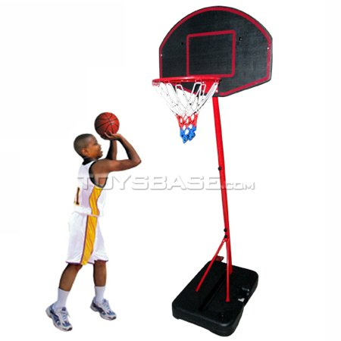
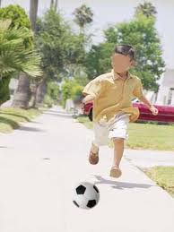
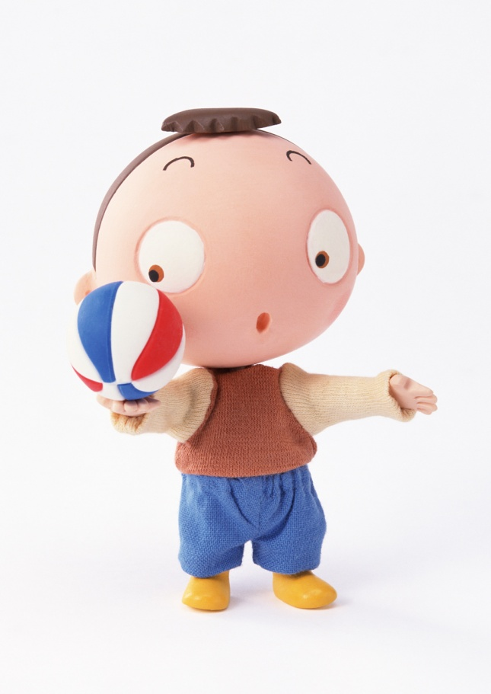

Slide 5
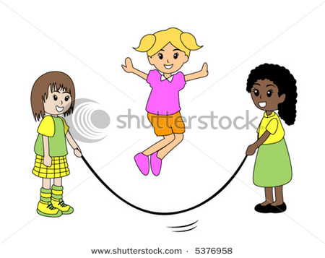
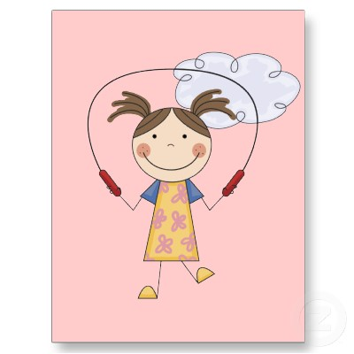

Slide 6
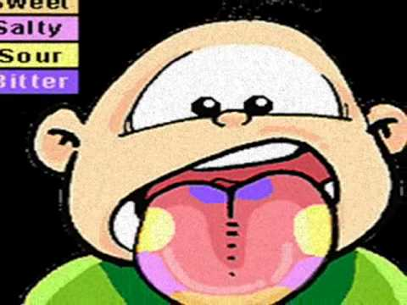
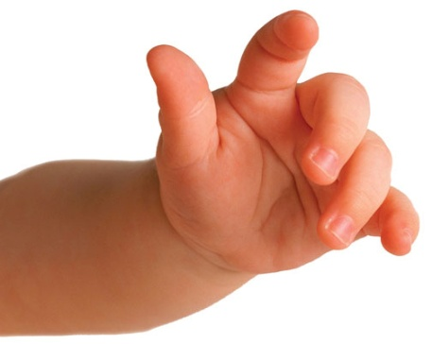
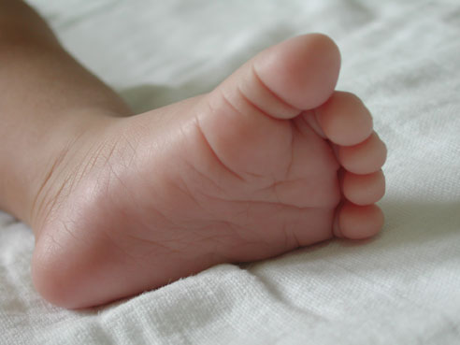
The part of my body
I have face بببببصببتت I have hand
I have foot
I have foot

Slide 7
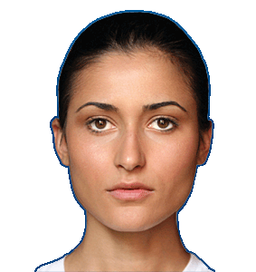
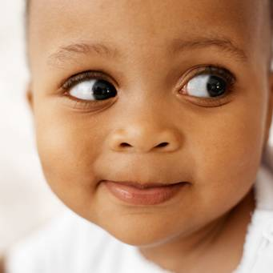
I have face

Slide 8
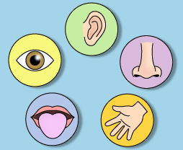
The part of the face
ear
eyes
noise
moth
hand

Slide 9
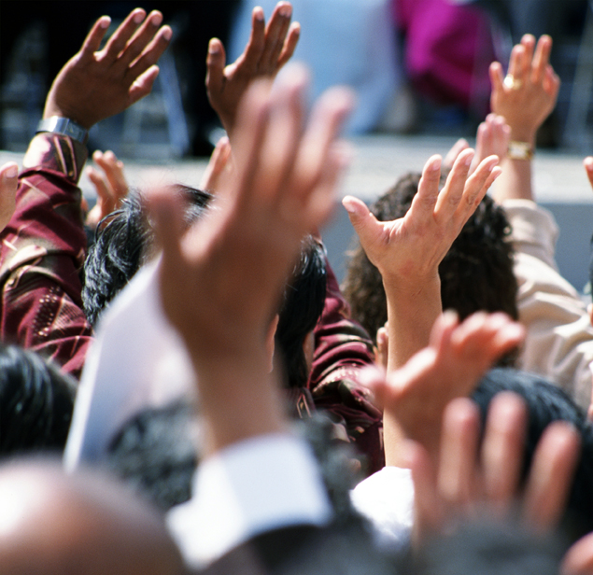
I have hand

Slide 10
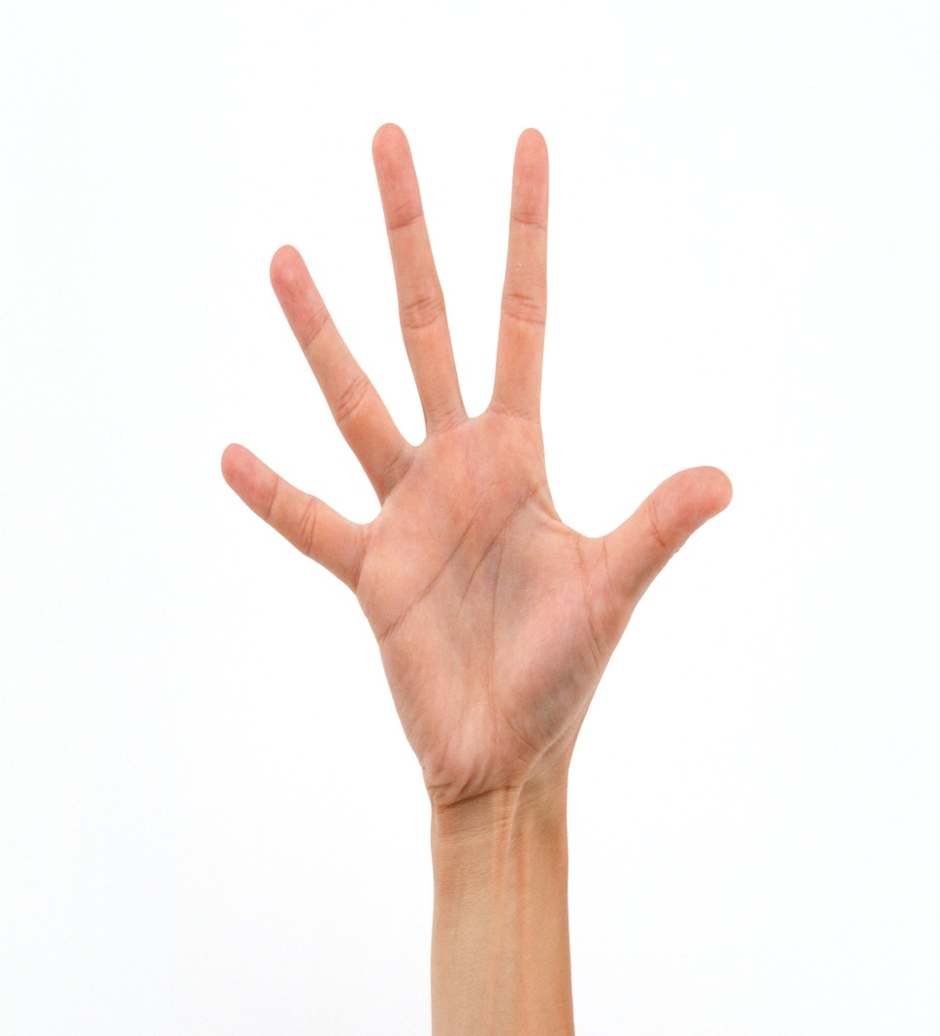
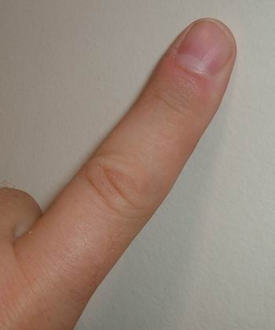
The part of the hand

Slide 11
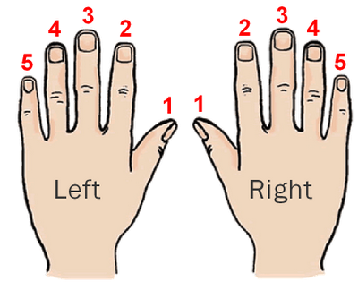

Slide 12
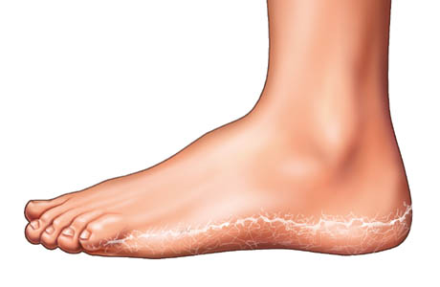
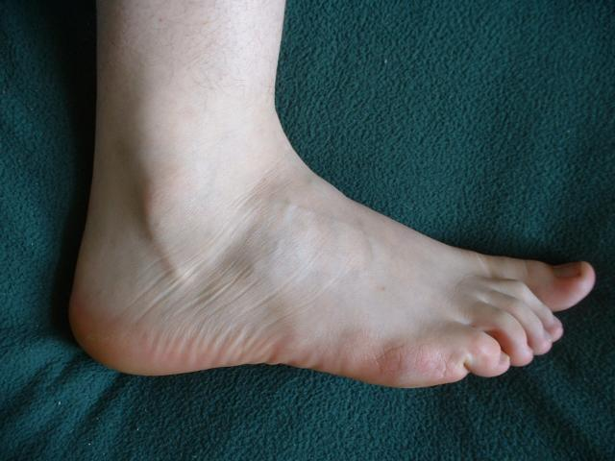
I have foot

Slide 13
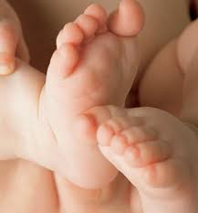
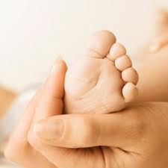

Slide 14
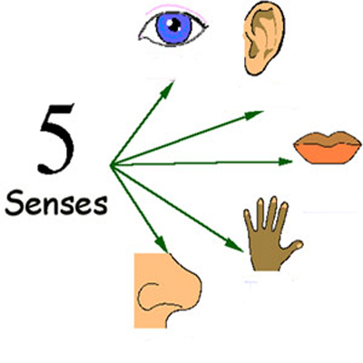
sight
Hearing
Taste
Touch
Smell

Slide 15
I can lesson

Slide 16
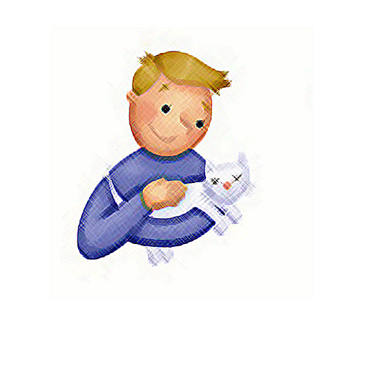
I can tough

Slide 17
I can smell

Slide 18
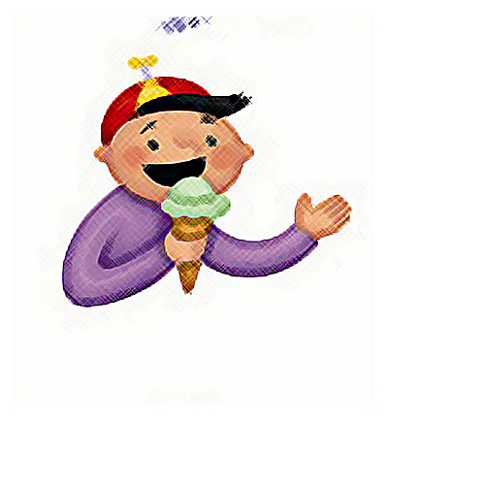
I can eat

Slide 19
I can read

Slide 20
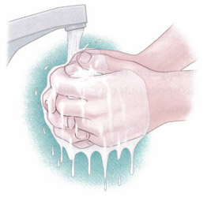

Slide 21
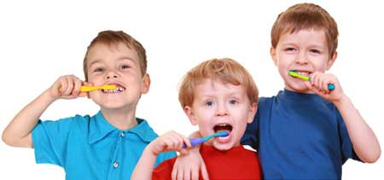

Slide 22
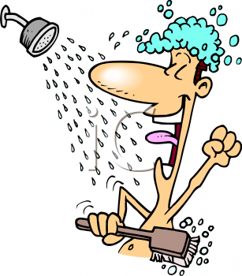
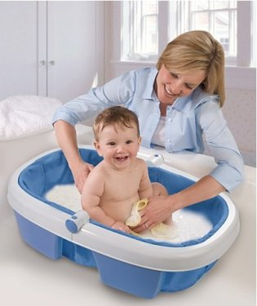

Slide 23
GAMES
1
2
3
4
5
6

Slide 24
1
؟How many senses do you have
1
5
7

Slide 25
Wright

Slide 26
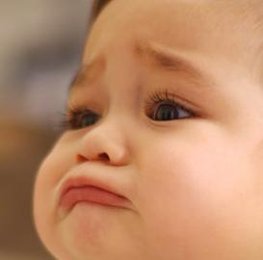
`
wrong

Slide 27
`
wrong

Slide 28
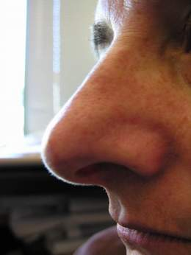
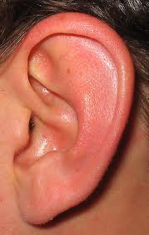
2
By witch sense you can smell the flower?
7
7
7

Slide 29
`
wrong

Slide 30
Wright

Slide 31
3
By witch sense you can eat the food?
7
7
7

Slide 32
Wright

Slide 33
`
wrong

Slide 34
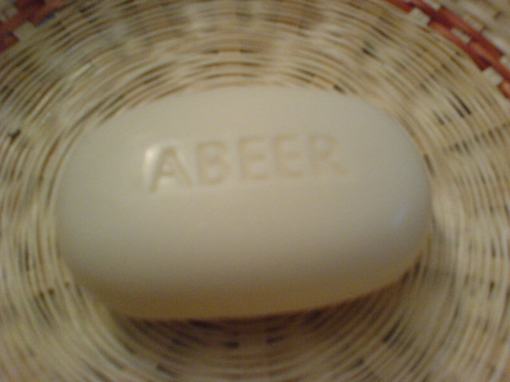
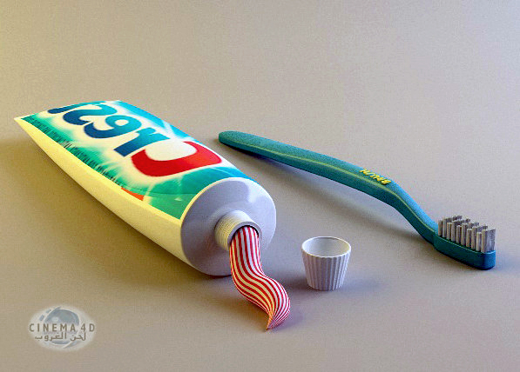
4
What you use to clean your mouth?

Slide 35
Wright

Slide 36
`
wrong

Slide 37
5
Do you think some part of your body move?
Yes
No

Slide 38
Wright

Slide 39
`
wrong

Slide 40
6
؟How many finger do you have in one hand
5
7
10

Slide 41
`
wrong

Slide 42
Wright

Slide 43
video
video

Slide 44
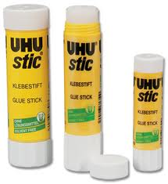
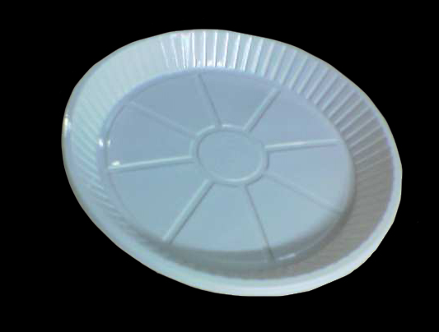
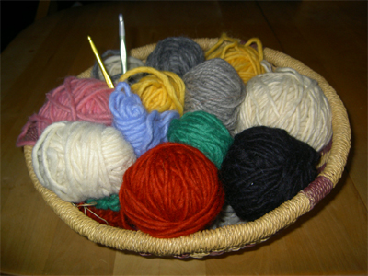
activity1

Slide 45
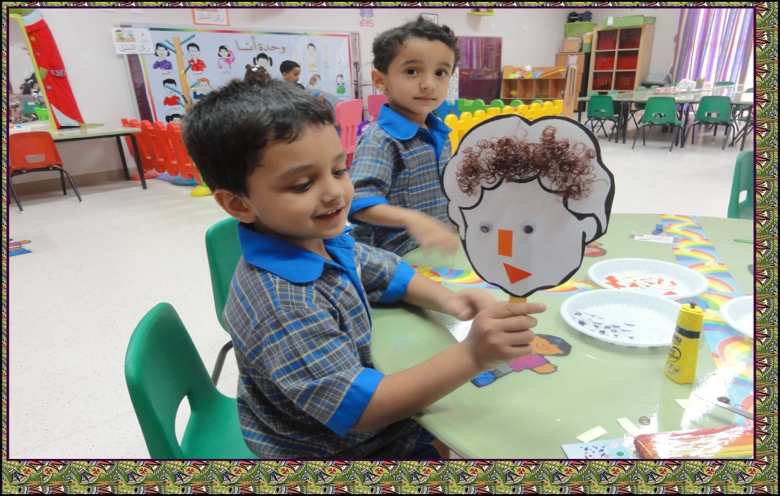
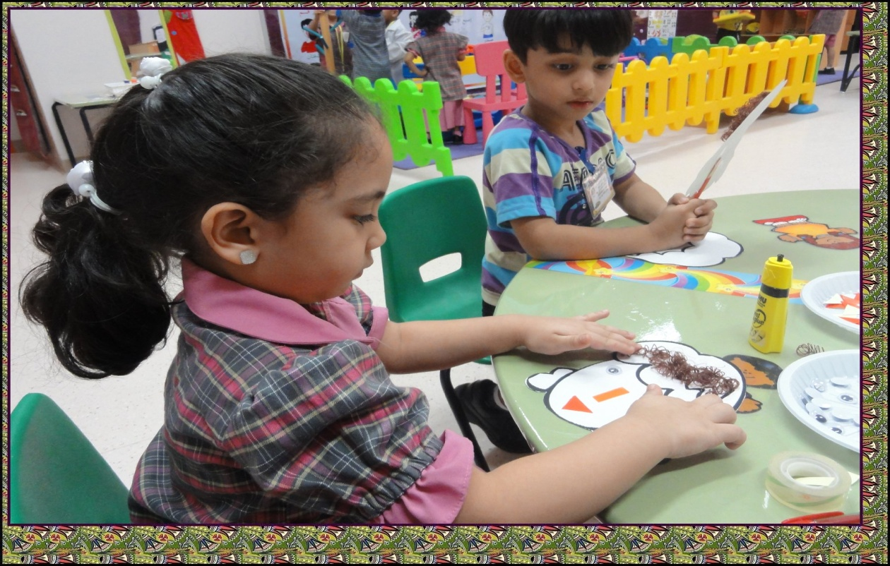

Slide 46
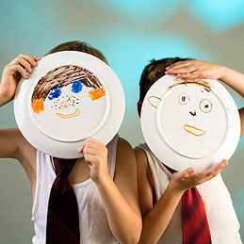
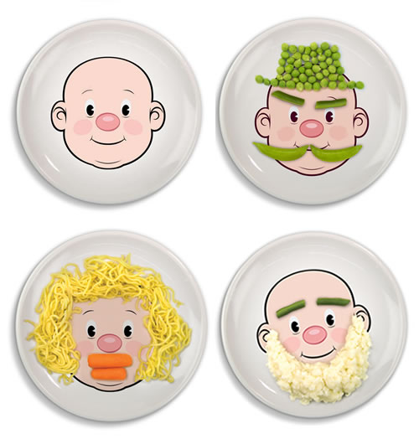

Slide 47
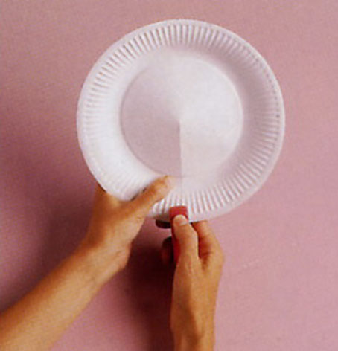
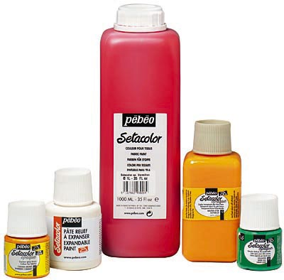
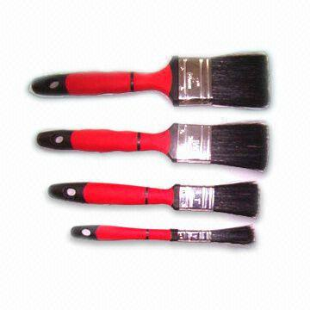
activity2

Slide 48
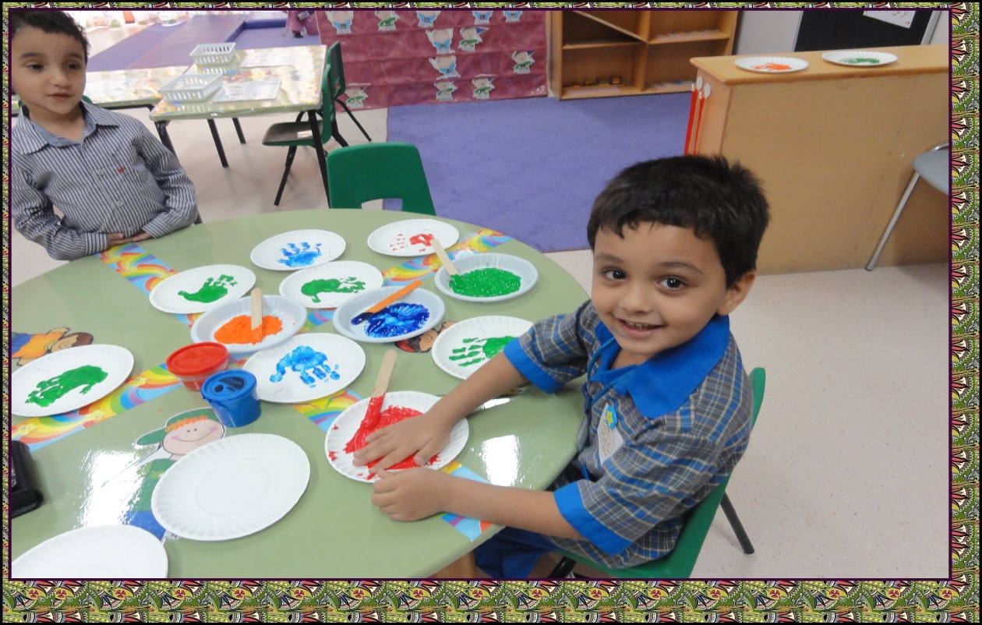

Slide 49
The End

